Slide 1
Precast/Prestressed Concrete Institute: Big Beam Competition
By: Roy Crouch, Stephen Gergal, Fernando Rojo, &
Brandy Wagoner

Slide 2


Background
PCI is a technical institute for the precast/prestressed concrete structures industry
What is Precast/prestressed concrete?
TPAC is a precast concrete company based in Phoenix, Az
Figure 1: Precast/Prestressed Concrete Institute logo [1]
Figure 2: TPAC logo [2]

Slide 3
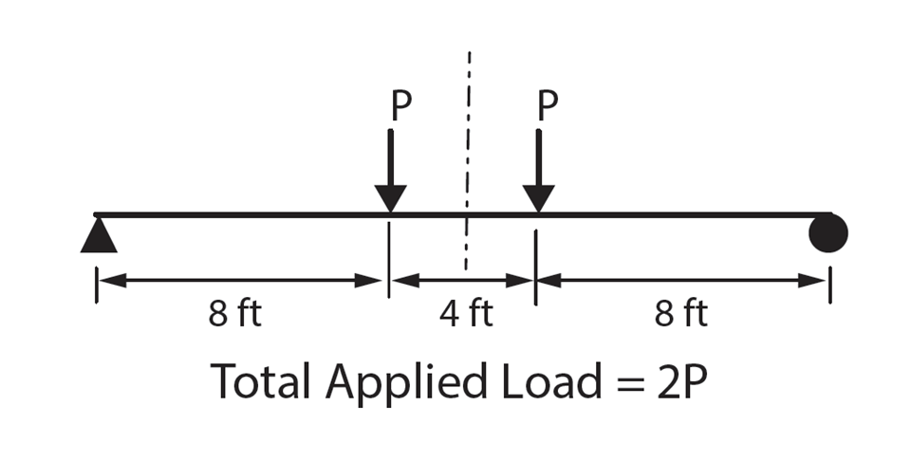
The Competition
The beam can’t be longer than 22 feet
The beam must fail between an unfactored loading of 32 and 39 kips
Scoring categories for beam
  Design accuracy
  Lowest cost
  Lowest weight
  Most accurate prediction
  Report quality
  Practicality, innovation and conformance to code
Figure 3: Image from PCI Big Beam Competition 2017-2018 brochure [3]

Slide 4
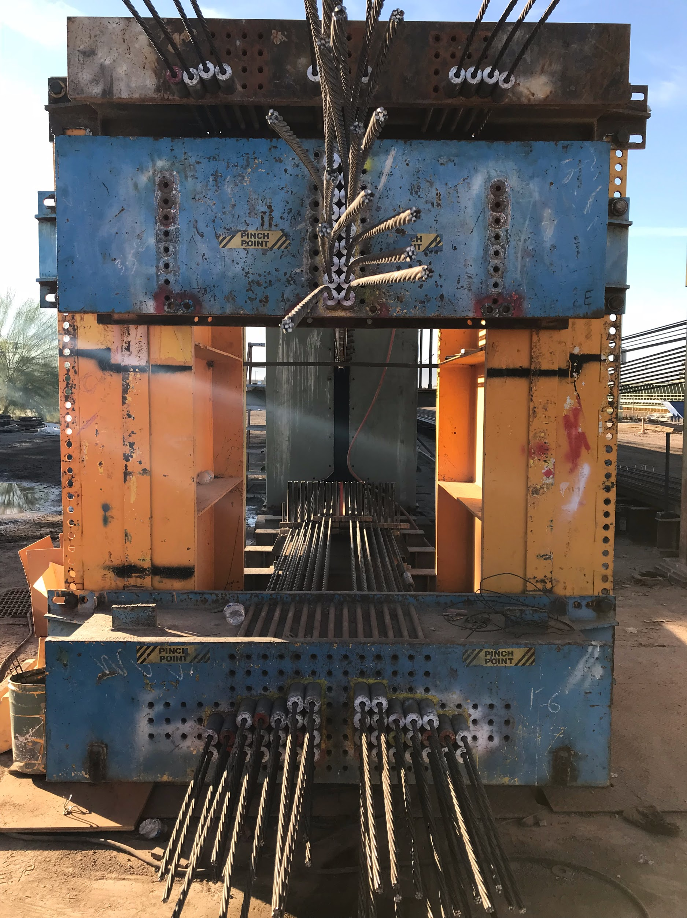
Scope
Photo by Roy Crouch
Mix Design
  Four mixes selected for analysis
  Compressive strength
  Tensile Strength
  Strain test
Beam Design
  Shape
  Deflection
Shop Drawings
  AutoCAD file
Figure 4: TPAC Anchorage Device

Slide 5
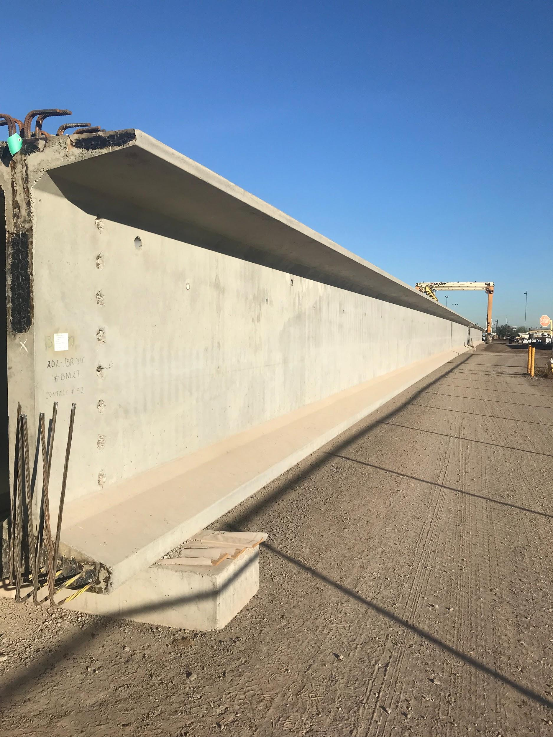
Scope
Photo by Fernando Rojo
Beam Fabrication
  TPAC (Phoenix)
Testing
  Hydraulic press
Transportation
  Phoenix to Flagstaff
Video
  Competition
    Recording of beam
Figure 5: 160ft long I beam from TPac

Slide 6
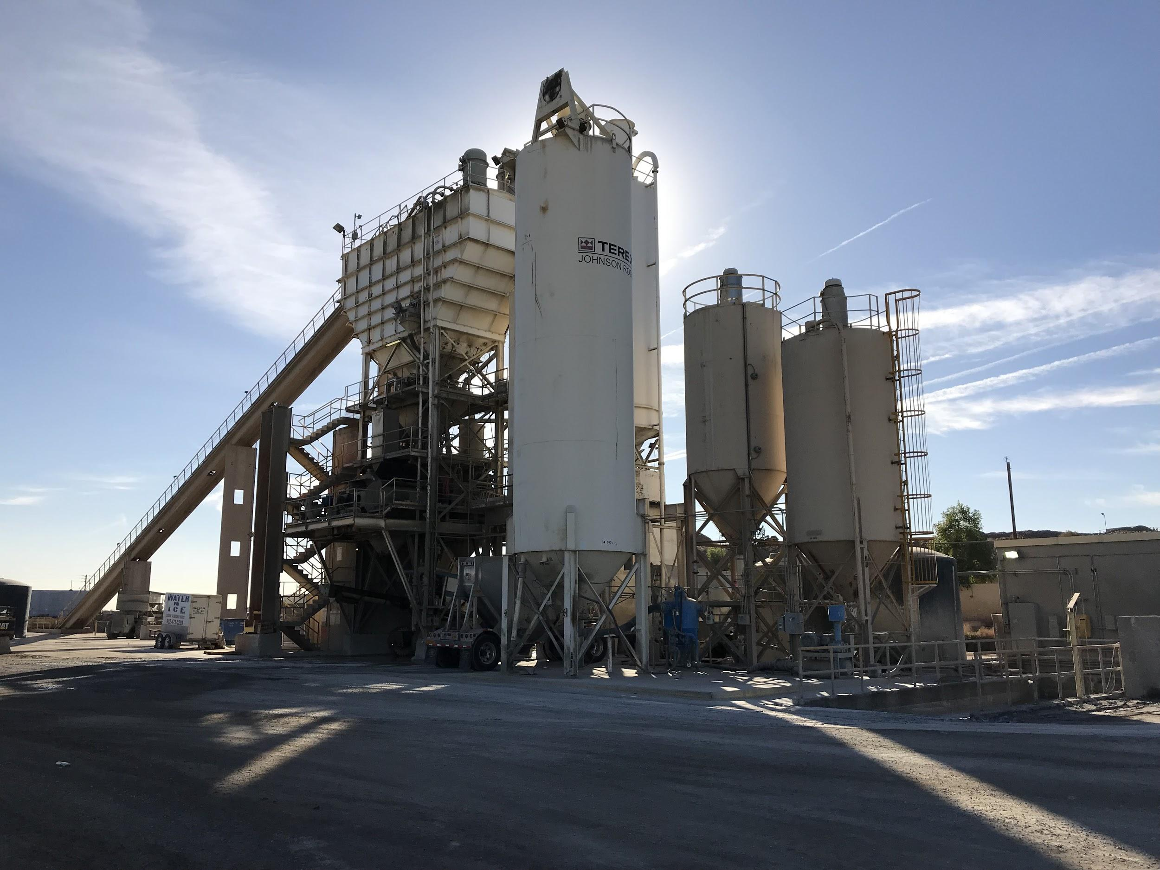
Schedule
2017
Mix Design
Collection of Materials for Testing
Concrete Testing
Cross Section Design
MathCAD Model 75% Compete
Photo by Roy Crouch
2018
Mix Selection
Cross Section Selection
Shop Drawings
Beam Fabrication/Transportation
Predictions
Testing
Final Report
Figure 6: Sponsor Site Visit

Slide 7
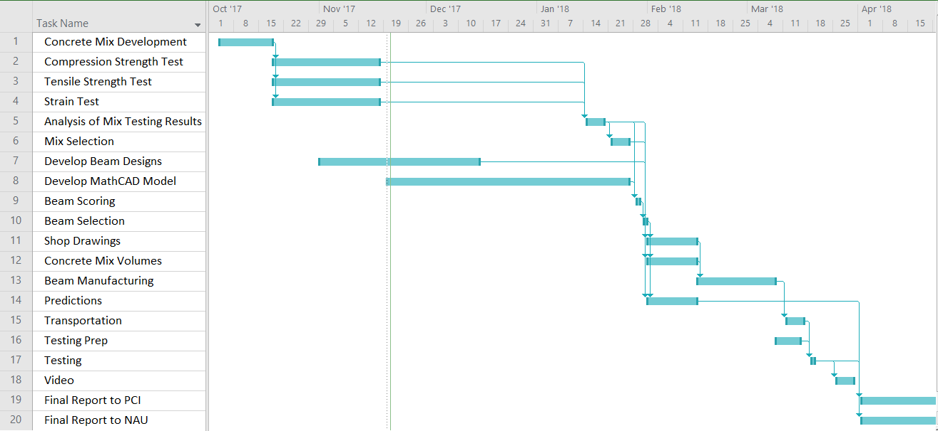
Legend:
= Critical Path
Figure 6: Gantt Chart
Chart created using Microsoft Project

Slide 8
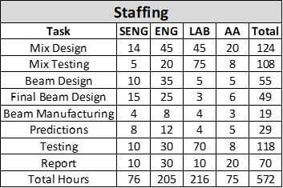
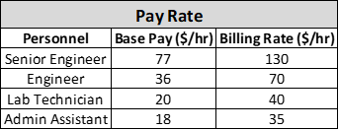
Cost of Engineering Services
Benefits Multiplier
Overhead
Company Profit
Table 2: Staffing Hours Distribution
Table 1: Position Compensation

Slide 9
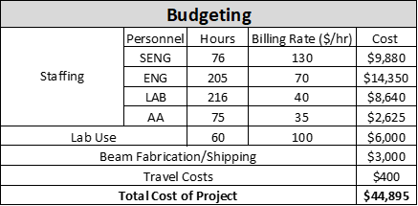
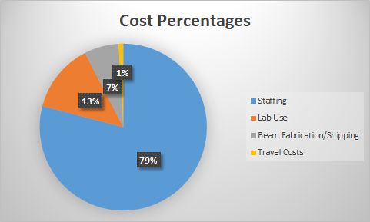
Cost of Engineering Services
Table 3: Cost of Project
FIgure 7: Cost Percentages

Slide 10
References
[1] TPAC, "TPAC Official Website," [Online]. Available: tpacaz.com. [Accessed 30 11 2017].
[2] Precast/Prestressed Concrete Institute, "PCI," [Online]. Available: pci.org.
[Accessed 30 11 2017].
[3] PCI, "2018 PCI Big Beam Brochure," [Online]. [Accessed 30 11 2017].

